Slide 1

Management Information Systems: Managing the Digital Firm
Sixteenth Edition
Chapter 10
E-commerce: Digital Markets, Digital Goods
Slide in this Presentation Contain Hyperlinks. JAWS users should be able to get a list of links by using INSERT+F7
Copyright © 2020, 2018, 2016 Pearson Education, Inc. All Rights Reserved
Notes:
If this PowerPoint presentation contains mathematical equations, you may need to check that your computer has the following installed:
1) MathType Plugin
2) Math Player (free versions available)
3) NVDA Reader (free versions available)

Slide 2
Learning Objectives
10.1 What are the unique features of e-commerce, digital markets, and digital goods?
10.2 What are the principal e-commerce business and revenue models?
10.3 How has e-commerce transformed marketing?
10.4 How has e-commerce affected business-to-business transactions?
10.5 What is the role of m-commerce in business, and what are the most important m-commerce applications?
10.6 What issues must be addressed when building an e-commerce presence?
10.7 How will M I S help my career?
Notes:
Students are participants in e-commerce and they love to talk about their experiences. You can start the conversation by asking if any in the class purchased something today or yesterday online. Draw students out to talk about their good and bad e-commerce experiences. How many have used their cell phones to search for products, or purchase products?

Slide 3
Video Cases
Case 1: Walmart Takes on Amazon: A Battle of I T and Management Systems
Case 2: Groupon: Deals Galore
Case 3: Etsy: A Marketplace and Community
Instructional Video 1: Walmart’s E-commerce Fulfillment Center Network
Instructional Video 2: Behind the Scenes of an Amazon Warehouse

Slide 4
YouTube Transforms the Media Landscape
Problem
Opportunities presented by new technology
Solutions
Streaming video
Piggyback advertising
Content subscription services
Illustrates some major trends in e-commerce
Sales of services
Advanced data mining and search technology
Mobile platforms

Slide 5
E-Commerce Today
E-commerce: Use of the Internet and Web to transact business
Began in 1995 and grew exponentially; still stable even in a recession
Companies that survived the dot-com bubble now thrive
The new e-commerce: social, mobile, local
Move from desktop to smartphone
Notes:
This slide discusses what e-commerce is, and what the state of e-commerce is today. The text states that e-commerce history mirrors that of other technology innovations. What other innovations is e-commerce similar to? Students probably will not know about the early days of radio and TV, but perhaps they will remember their parents’ cassette music, VHS video tapes, and even CDs and DVDs, which, though still with us, have markedly declined in sales. The book discusses new trends in e-commerce. Ask the students to work with you to list some of these new trends in e-commerce.

Slide 6
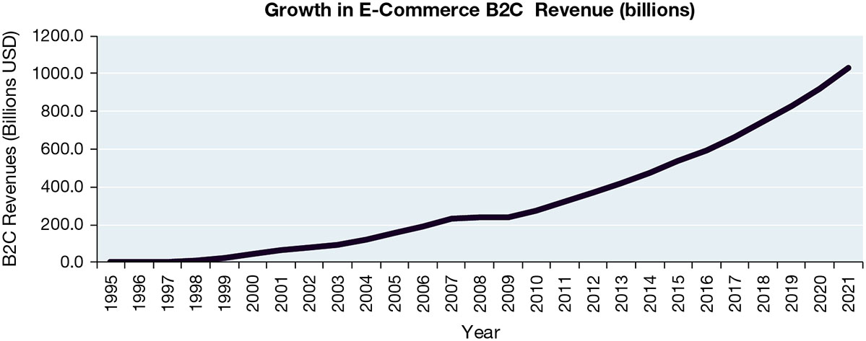
Figure 10.1 The Growth of E-Commerce
Notes:
Figure 10.1, Page 376.
Retail e-commerce revenues grew 15–25 percent per year until the recession of 2008–2009, when they slowed measurably. In 2017, e-commerce revenues grew at an estimated 16 percent annually.
Sources: Based on data from eMarketer, “US Retail Ecommerce Sales, 2018–2022,” 2018c; eMarketer, “US Digital Travel Sales, 2018–2022,” 2018a; and eMarketer chart, “US Mobile Downloads and In-App Revenues, 2013–2017,” 2017a.
This graphic illustrates the continuing growth of e-commerce. The growth of e-commerce revenues grew 15 percent to 25 percent a year until the recession of 2008–2009, when they slowed measurably to a small positive number around 3 percent in 2009. This was much better than traditional retail commerce, which actually shrank in this recession. E-commerce began growing again after 2009 at more than 10 percent, several times the growth of all retail sales.
Full description: This line graph charts the continuing growth of e-commerce, between 19 95 and 20 21. E-commerce revenues grow from just over 0 in 19 95 to about 240 billion in 20 07, when sales flatten until 20 09. From 20 09 through 20 21, revenue grows from about 240 billion to about 1,050 billion in 20 21.

Slide 7
Why E-Commerce is Different (1 of 2)
Ubiquity
Marketspace is virtual
Transaction costs reduced
Global reach
Transactions cross cultural and national boundaries
Universal standards
One set of technology standards: Internet standards
Richness
Supports video, audio, and text messages
Notes:
This slide introduces the unique features of the Internet. These features explain why e-commerce has grown so quickly—because of the unique nature of the Internet and e-commerce, which are richer and more powerful than previous technology revolutions such as radio and TV.
Ask students to provide real-life examples of these effects, for example:
Ubiquity—being able to surf the web on your mobile device while riding a bus or train.
Global reach—being able to buy products from another country.
Universal standards—being able to exchange files with someone else.
Richness—YouTube.

Slide 8
Why E-Commerce is Different (2 of 2)
Interactivity
Information density
Greater price and cost transparency
Enables price discrimination
Personalization/customization
Technology permits modification of messages, goods
Social technology
Promotes user content generation and social networking
Notes:
Ask students to provide real-life examples of these effects, for example:
Interactivity—using a chat window to interact with technical support at a merchant’s website.
Information density—being able to find hundreds of prices for the same product online from different merchants.
Personalization—website that adjusts to your preferences, such as Amazon.
Social technology—uploading videos to YouTube.

Slide 9
Key Concepts in E-Commerce – Digital Markets and Digital Goods in a Global Marketplace
Internet and digital markets have changed the way companies conduct business
Information asymmetry reduced
Menu costs, search and transaction costs reduced
Dynamic pricing enabled
Switching costs
Delayed gratification
Disintermediation
Notes:
This slide introduces digital markets and discusses the effects of digital markets on the ways companies conduct business. Ask students to define the terms listed here, and also to explain how each of these effects (lowered information asymmetry, etc.) are created by digital markets. Go through each of the three types of costs involved in any marketplace. Students may not be familiar with these concepts, but they will be familiar with the phenomenon. For instance, all students will recognize that it takes time and money to go to a mall to find a shirt (this is search cost). The same shirt can be bought on the Web today with minimal search costs.

Slide 10
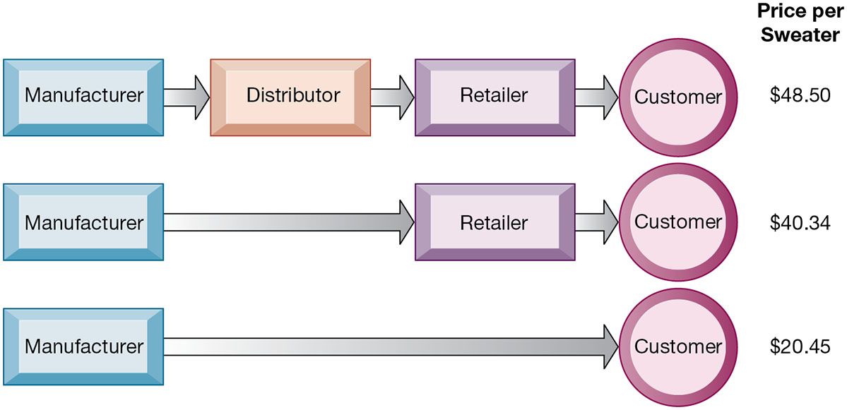
Figure 10.2 The Benefits of Disintermediation to the Consumer
Notes:
Figure 10.2, Page 383.
The typical distribution channel has several intermediary layers, each of which adds to the final cost of a product, such as a sweater. Removing layers lowers the final cost to the customer.
This graphic illustrates how disintermediation reduces prices to consumers. It also allows manufacturers to earn more profit for the product by eliminating the middle man. Are middle men really necessary? You should ask students who they think is a “middle man.” Walmart is, for instance, a distributor and retailer. Do they provide an important function? Why can’t manufacturers just ignore Walmart and sell directly to the customer? Even though market disintermediation sounds like a good thing because costs and prices go down, for the most part manufacturers kept their distribution partners and channels. Walmart is still needed by manufacturers such as P&G to sell soap.
Full description: This graphic illustrates how disintermediation reduces prices to consumers. The diagram shows three examples of manufacturers with different levels of intermediation and how these levels related to the cost of the same sweater. In the top example, a distributor and retailer intermediate between the manufacturer and customer, resulting in a sweater price of 48.50 dollars. In the second example, just a retailer intermediates between manufacturer and customer, and the sweater price drops to 40.34 dollars. In the third example, there is no intermediation between manufacturer and customer, and the price of the sweater has dropped to 20.45 dollars.

Slide 11
Digital Goods
Goods that can be delivered over a digital network
Cost of producing first unit is almost entire cost of product
Costs of delivery over the Internet very low
Marketing costs remain the same; pricing highly variable
Industries with digital goods are undergoing revolutionary changes (publishers, record labels, etc.)
Notes:
This slide continues the discussion of key concepts in e-commerce, looking at digital goods and how these compare with traditional goods.
Ask students how their purchases of digital goods have changed over the past five years. What benefits and drawbacks do they have? Music for instance used to be a physical product (record or CD) not a digital product or digital service.

Slide 12
Types of E-Commerce
Three major types
Business-to-consumer (B2C)
Example: Barnes and Noble.com
Business-to-business (B2B)
Example: ChemConnect
Consumer-to-consumer (C2C)
Example: e Bay
E-commerce can be categorized by platform
Mobile commerce (m-commerce)
Notes:
This slide introduces the types of e-commerce. B2C, B2B, and C2C e-commerce are categorized according to the nature of the participants. M-commerce is a category based on the nature of the connection to the Internet. Ask students to provide examples of the different types of e-commerce listed here. Most students will find it hard to come up with a B2B example. One place you can visit on the Web is grainger.com, one of the largest B2B marketplaces in the United States. Another is mcmaster.com, and also elemica.com (chemical industry).

Slide 13
E-Commerce Business Models
Portal
E-tailer
Content provider
Transaction broker
Market creator
Service provider
Community provider
Notes:
This slide continues the discussion of new Internet business models. Ask students to give examples of these business models. For each model, ask students about their experience, or ask for examples for each model. Ask how these business models create revenue. For instance:
Content provider revenue: access fees, advertising
Portal revenue: advertising
Service provider revenue: subscription fees, advertising
Community provider (could be Facebook) revenue: sales of virtual goods, display ads

Slide 14
Interactive Session – Organizations: Uber: Digital Disruptor
Class discussion
Analyze Uber using the competitive forces and value chain models. What is its competitive advantage?
What is the relationship between information technology and Uber’s business model? Explain your answer.
How disruptive is Uber?
Is Uber a viable business? Explain your answer.

Slide 15
E-Commerce Revenue Models
Advertising
Sales
Subscription
Free/Freemium
Transaction fee
Affiliate
Notes:
This slide and the next several slides discuss new business models that are enabled by the Internet and e-commerce. Although many of the new business models are pure-play, some, especially in the retail industry, are clicks-and-mortar.
Some of the new models take advantage of the Internet’s communication capabilities, such as the social networking sites. Ask students what other sites take advantage of the Internet’s communication abilities.

Slide 16
How Has E-commerce Transformed Marketing?
Internet provides new ways to identify and communicate with customers
Long tail marketing
Internet advertising formats
Behavioral targeting
Tracking online behavior of individuals
Programmatic ad buying
Native advertising
Notes:
Ask students to explain why marketers are looking to analyze blog content, and content from chat rooms and message boards. Have students describe and evaluate their experiences with advertising on social networks, via email and other online formats.

Slide 17
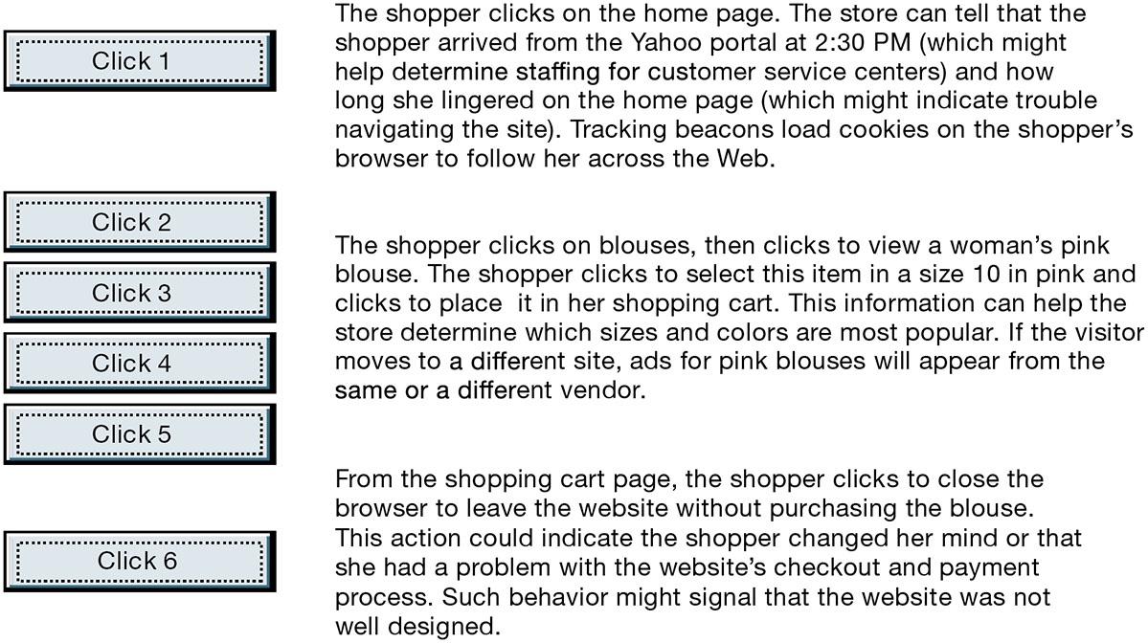
Figure 10.3 Website Visitor Tracking
Notes:
Figure 10.3, Page 394.
E-commerce websites and advertising platforms like Google’s DoubleClick have tools to track a shopper’s every step through an online store and then across the Web as shoppers move from site to site. Close examination of customer behavior at a website selling women’s clothing shows what the store might learn at each step and what actions it could take to increase sales.
This graphic illustrates how clickstream tracking works and what the store can tell about the activities of a shopper on their website. Extensive metrics exist for various types of user behavior, from the time spent on a web page to the number of products ordered and placed in a shopping cart but not purchased.
Full description: A diagram shows the process of tracking website visitors. The process shown is as follows. Click 1, The shopper clicks on the home page. The store can tell that the shopper arrived from the Yahoo portal at 2:30 PM, which might help determine staffing for customer service centers, and how long she lingered on the home page, which might indicate trouble navigating the site. Tracking beacons load cookies on the shopper's browser to follow her across the Web. Click 2 to Click 5, The shopper clicks on blouses, clicks to select a woman's white blouse, and then clicks to view the same item in pink. The shopper clicks to select this item in size 10 in pink and clicks to place it in her shopping cart. This information can help the store determine which sizes and colors are most popular. If the visitor moves to a different site, ads for pink blouses will appear from the same or a different vendor. Click 6, From the shopping cart page, the shopper clicks to close the browser to leave the website without purchasing the blouse. This action could indicate the shopper changed her mind or that she had a problem with the website's checkout and payment process. Such behavior might signal that the website was not well designed.

Slide 18
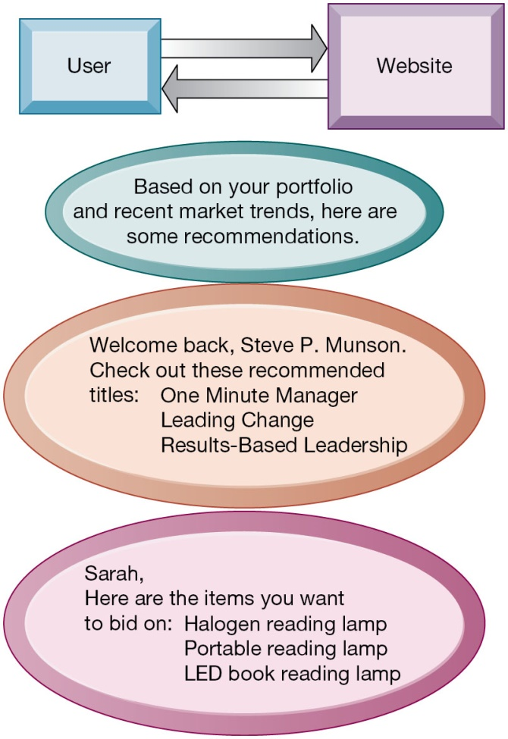
Figure 10.4 Website Personalization
Notes:
Figure 10.4, Page 395.
Firms can create unique personalized web pages that display content or ads for products or services of special interest to individual users, improving the customer experience and creating additional value.
This graphic illustrates some of the types of personalization that clickstream tracking can make possible. Have students found suggestions made by a website useful in their experience? You can go to Amazon.com and illustrate how recommender systems work. Search for a product, and then scroll to the bottom of the page where Amazon’s recommender will tell you what other people who looked at the current page actually bought. Netflix is also an excellent site to demonstrate personalization.
Full description: This graphic illustrates some of the types of personalization that clickstream tracking can make possible. It shows three examples of personalization between a User and a website. In the first, the website presents a message that reads: Based on your portfolio and recent market trends, here are some recommendations. In the second example, a personalized message reads, Welcome back, Steve. P. Munson. Check out these recommended titles. One Minute Manager, Leading Change, Results Based Leadership. The final example of a personalized message is: Sarah, here are the items you want to bid on. Halogen reading lamp, Portable reading lamp, L E D book reading lamp.

Slide 19
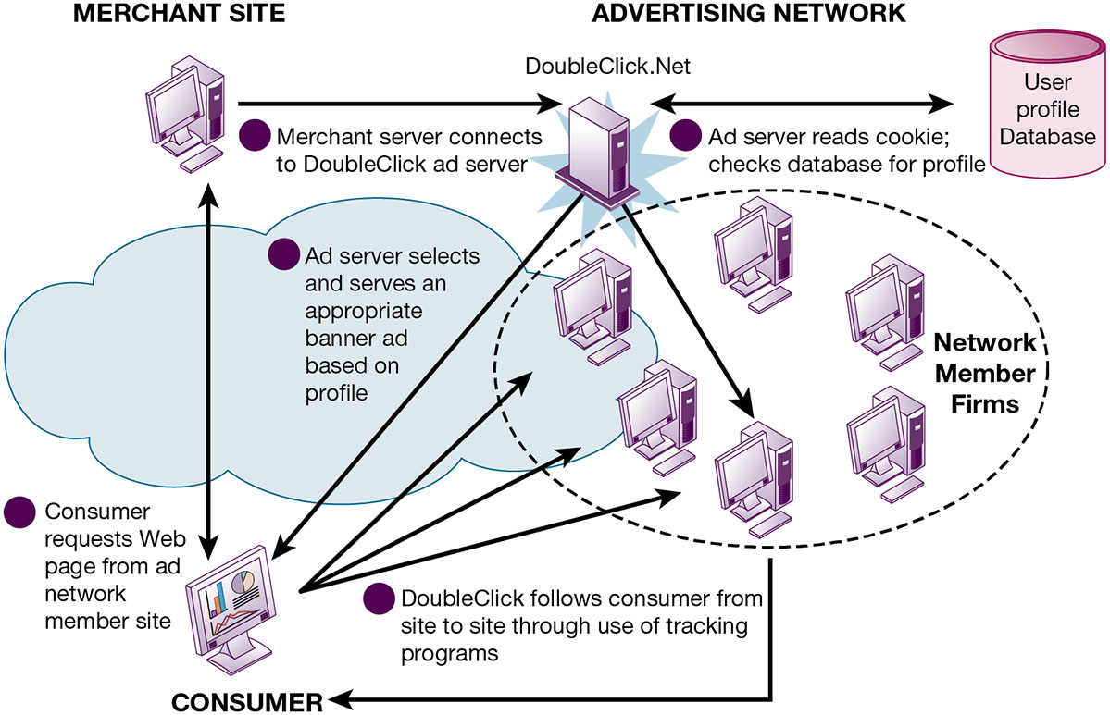
Figure 10.5 How an Advertising Network Such as DoubleClick Works
Notes:
Figure 10.5, Page 396.
Advertising networks and their use of tracking programs have become controversial among privacy advocates because of their ability to track individual consumers across the Internet.
What do students think (or do they think) about how advertising networks follow them around the Internet? It’s actually quite difficult for anyone to know when they are being tracked by a network, and even more difficult to find out how the information is being used?
Full description: This graphic illustrates how an advertising network works, as follows. A consumer requests a web page from one of multiple ad network member sites. The merchant server connects to a DoubleClick ad server. The DoubleClick ad server reads the cookie and checks a user profile database for the consumer’s profile. It then selects and serves the consumer an appropriate banner ad based on his or her profile. DoubleClick continues to follow the consumer from site to site through the use of tracking programs.

Slide 20
Social E-Commerce and Social Network Marketing (1 of 2)
Social e-commerce based on digital social graph
Features of social e-commerce driving its growth
Newsfeed
Timelines
Social sign-on
Collaborative shopping
Network notification
Social search (recommendations)
Social media
Fastest growing media for branding and marketing
Notes:
Ask your class who has a Facebook page. A sea of hands will rise. How many have purchased something while on their Facebook page, or clicks routinely on ads? Generally, people do not go to Facebook to buy things and are not clicking on display ads (about 3 percent of users in the U.S.) although this is growing rapidly and is much larger than display ads on other sites like Yahoo.

Slide 21
Social E-Commerce and Social Network Marketing (2 of 2)
Social network marketing
Seeks to leverage individuals’ influence over others
Targeting a social network of people sharing interests and advice
Facebook’s “Like” button
Social networks have huge audiences
Social shopping sites
Wisdom of crowds
Crowdsourcing
Notes:
Facebook’s social network grew rapidly, and now reaches over 2 billion people worldwide, with 210 million in the United States. LinkedIn has 500 million monthly visitors.
Most students will be well aware of social networking technologies, but have they heard of prediction markets? Ask them to investigate this further on their own time. How can these techniques and phenomenon be used by business firms? LinkedIn is the largest professional and business social network that members often use to recruit employees and find jobs.

Slide 22
Interactive Session – Management: “Socializing” with Customers
Class discussion
Assess the people, organization, and technology issues for using social media technology to engage with customers.
What are the advantages and disadvantages of using social media for advertising, brand building, market research, and customer service?
Give an example of a business decision in this case study that was facilitated by using social media to interact with customers.
Should all companies use social media technology for customer service and marketing? Why or why not? What kinds of companies are best suited to use these platforms?

Slide 23
How Has E-Commerce Affected Business-To Business Transactions?
U.S. B2B trade in 2019 is $13.5 trillion
U.S. B2B e-commerce in 2018 is $6.2 trillion
Internet and networking helps automate procurement
Variety of Internet-enabled technologies used in B2B
Electronic data interchange (E D I)
Private industrial networks (private exchanges)
Net marketplaces
Exchanges
Notes:
This slide looks at changes brought to B2B e-commerce by Internet technologies. Note that the Internet and web technology enable businesses to create new electronic storefronts for selling to other businesses with multimedia graphic displays and interactive features similar to those for B2C commerce. Alternatively, businesses can use Internet technology to create extranets or electronic marketplaces for linking to other businesses for purchase and sale transactions.

Slide 24
Electronic Data Interchange (E D I)
Computer-to-computer exchange of standard transactions such as invoices, purchase orders
Major industries have E D I standards
Define structure and information fields of electronic documents
More companies are moving toward web-enabled private networks
Allow them to link to a wider variety of firms than E D I allows
Enable sharing a wider range of information

Slide 25
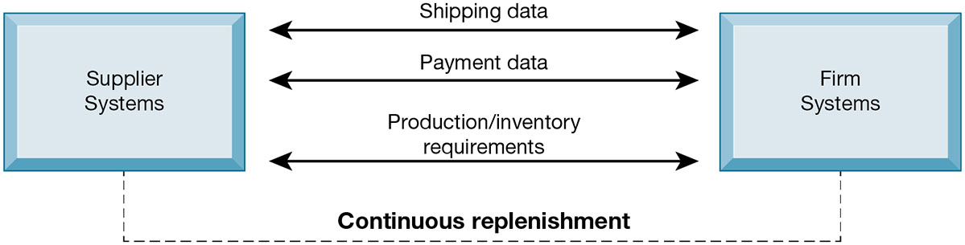
Figure 10.6: Electronic Data Interchange (E D I)
Notes:
Figure 10.6, Page 401.
Companies use EDI to automate transactions for B2B e-commerce and continuous inventory replenishment. Suppliers can automatically send data about shipments to purchasing firms. The purchasing firms can use EDI to provide production and inventory requirements and payment data to suppliers.
This graphic illustrates EDI is still widely used but it has limitations outlined in the book and is not designed for supporting marketplace operations where you have hundreds of vendors and buyers. how EDI is used by firms and their suppliers to automate transactions for both B2B e-commerce and continuous replenishment.
Full description: This graphic illustrates how EDI works. EDI allows shipping data, payment data, and production and inventory requirements between supplier systems and firm systems. These allow for continuous replenishment.

Slide 26
New Ways of B2B Buying and Selling
Private industrial networks
Private exchanges
Large firm using a secure website to link to suppliers and partners
Net marketplaces (e-hubs)
Single digital marketplace for many buyers and sellers
May focus on direct or indirect goods
May be vertical or horizontal marketplaces
Exchanges
Independently owned third-party Net marketplaces for spot purchasing
Notes:
This slide continues the discussion of ways the Internet and web technologies have changed B2B e-commerce. One way is in using an extranet to link to the firm’s suppliers. The text provides the example of VW Group Supply, which links the Volkswagen Group and its suppliers. VW Group Supply handles 90 percent of all global purchasing for Volkswagen, including all automotive and parts components.
This slide continues the discussion of ways the Internet and web technologies have changed B2B e-commerce, in this case by the ability to create Net marketplaces. Ask students to distinguish between and provide examples of direct and indirect goods. (Direct goods are goods used in a production process, such as sheet steel for auto body production. Indirect goods are all other goods not directly involved in the production process, such as office supplies or products for maintenance and repair.)
Ask students to distinguish between vertical and horizontal marketplaces.
This slide continues the discussion of ways the Internet and web technologies have changed B2B e-commerce, in this case by the ability to create exchanges. The text provides the example of GoToPaper, which creates a spot market for paper products in 75 countries.

Slide 27
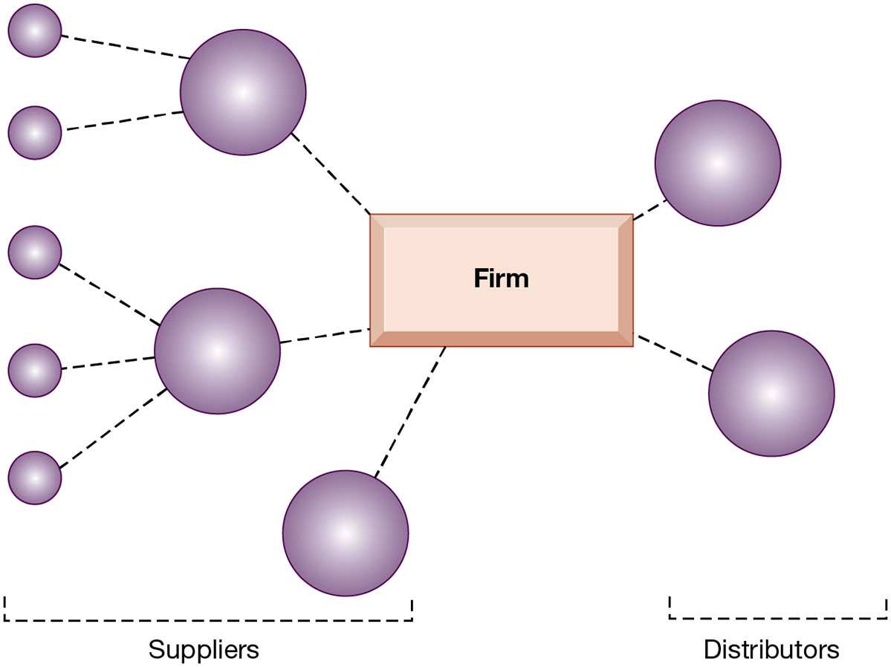
Figure 10.7 A Private Industrial Network
Notes:
Figure 10.7, Page 402.
A private industrial network, also known as a private exchange, links a firm to its suppliers, distributors, and other key business partners for efficient supply chain management and other collaborative commerce activities.
This graphic illustrates a private industrial network, and how it can link to both suppliers and distributors. Private industrial networks are owned by the company that uses and creates them. They are “private” and you need to be asked to join.

Slide 28
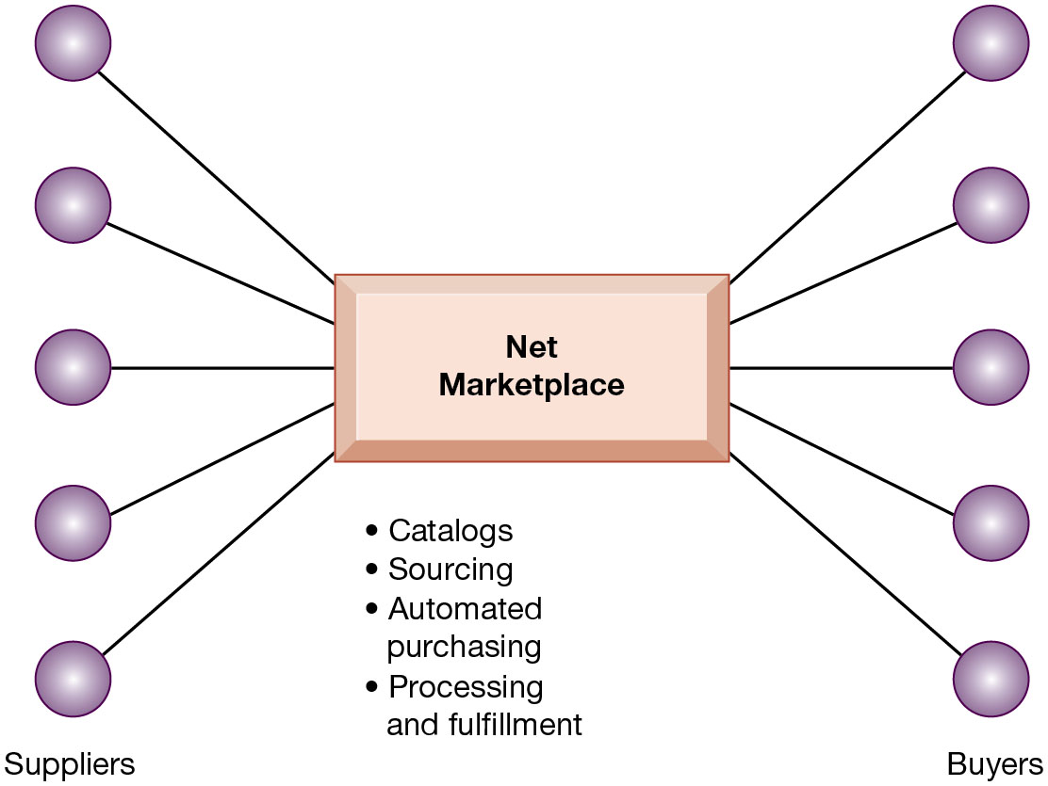
Figure 10.8 A Net Marketplace
Notes:
Figure 10.8, Page 403.
Net marketplaces are online marketplaces where multiple buyers can purchase from multiple sellers.
This graphic illustrates a net marketplace, and the functions that it can provide to participants in managing their transactions. The text provides the example of Exostar, an aerospace and defense industry-sponsored Net marketplace that focuses on long-term contract purchasing relationships and on providing common networks and computing platforms for reducing supply chain inefficiencies. More than 16,000 trading partners in the commercial, military, and government sectors use Exostar’s sourcing, e-procurement, and collaboration tools for both direct and indirect goods.
Full description: This graphic illustrates a net marketplace, and the functions that it can provide to participants in managing their transactions. The net marketplace serves multiple suppliers and multiple buyers, providing the following services: catalogs, sourcing, automated purchasing, and processing and fulfillment.

Slide 29
What is the Role of M-Commerce in Business, and What are the Most Important M-Commerce Applications?
M-commerce in 2017 is 35 percent of all e-commerce
Fastest growing form of e-commerce
Growing at 20 percent or more per year
Main areas of growth
Mass market retailing (Amazon, eBay, etc.)
Sales of digital content (music, T V, etc.)
In-app sales to mobile devices
Notes:
This slide introduces m-commerce, the use of wireless mobile devices for purchasing goods and services. Ask students what applications and services they use with their cell phones. Have any purchased games or entertainment, and from what companies? Have any used OpenTable on a smartphone?

Slide 30
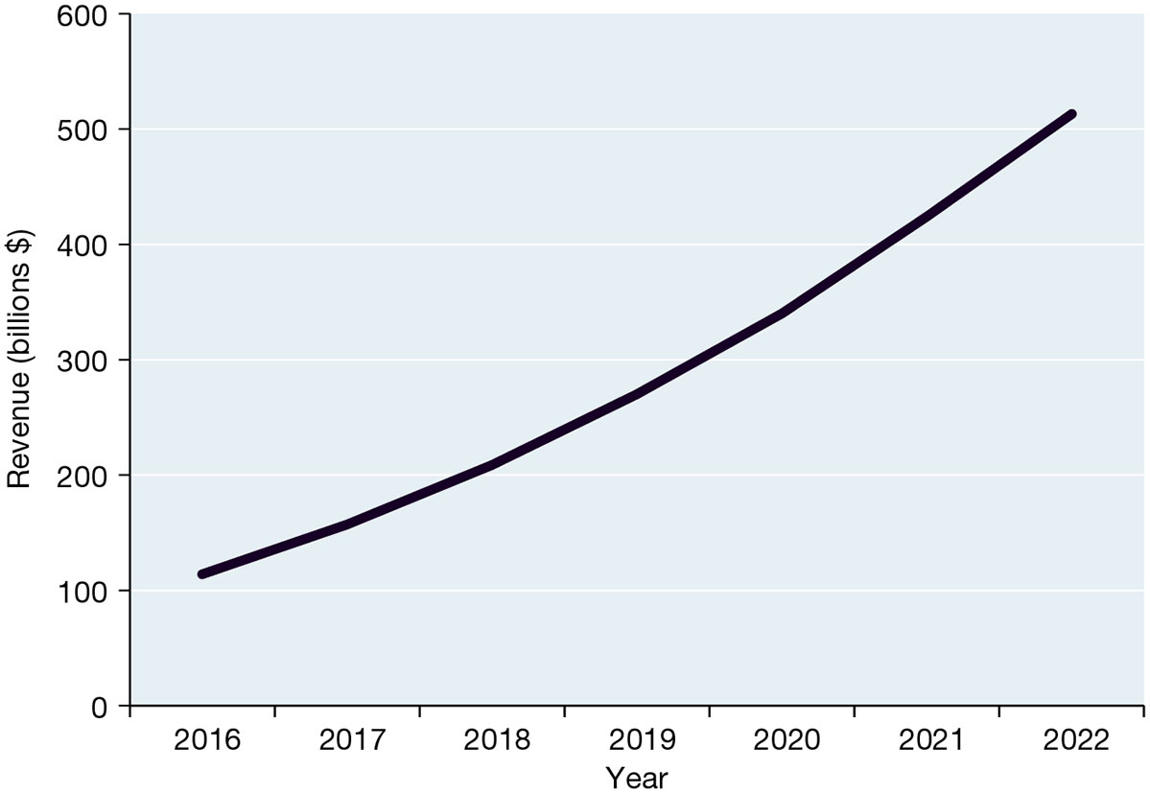
Figure 10.9 Mobile Retail Commerce Revenues
Notes:
Figure 10.9, Page 404.
Mobile e-commerce is the fastest-growing type of B2C e-commerce and represented about 34 percent of all e-commerce in 2018.
Sources: Data from eMarketer chart “Retail Mcommerce Sales, US, (billions) 2018–2022,” eMarketer, 2018d.
This graph illustrates the surging growth of m-commerce sales from today to 2021. In the early years prior to 2009, m-commerce in the United States was very small and not growing rapidly. Cell phones, especially smartphones, have changed that. Have any of the students purchased something using their cell phone or mobile laptop computer? How many students are using a smartphone? How many have used a smartphone app to compare prices while shopping at stores?
Full description: This line graph illustrates the surging growth of m-commerce sales from today to 2022. In 20 16, mobile retail commerce revenues are approximately 110 billion dollars. Revenues increase rapidly through 20 22, which shows revenues of about 510 billion dollars.

Slide 31
Location-Based Services and Applications
Used by 74 percent of smartphone owners
Based on G P S map services
Geosocial services
Where friends are
Geo advertising
What shops are nearby
Geo information services
Price of house you are passing
Notes:
Google Maps is arguably the most common example of location-based services. Foursquare is another good example to visit during class.

Slide 32
Other Mobile Commerce Services
Financial account management apps
Banks, credit card companies
Mobile advertising market
Google and Facebook are largest markets
Ads embedded in games, videos, and mobile apps
55 percent of online retailers have m-commerce websites

Slide 33
What Issues Must Be Addressed When Building an E-Commerce Presence?
Most important management challenges
Developing clear understanding of business objectives
Knowing how to choose the right technology to achieve those objectives
Develop an e-commerce presence map
Four areas: websites, e-mail, social media, offline media
Develop a timeline: milestones
Breaking a project into discrete phases
Notes:
Building a website involves a number of considerations. If its an e-commerce site, customer preferences should be the driving force behind the design. What are customers looking for, how can they find it on your site, and how easily can they purchase on your site? How will you choose the technology? What about your sites information policy? What’s that? If you don’t know, your customers will surely expect you to know.

Slide 34
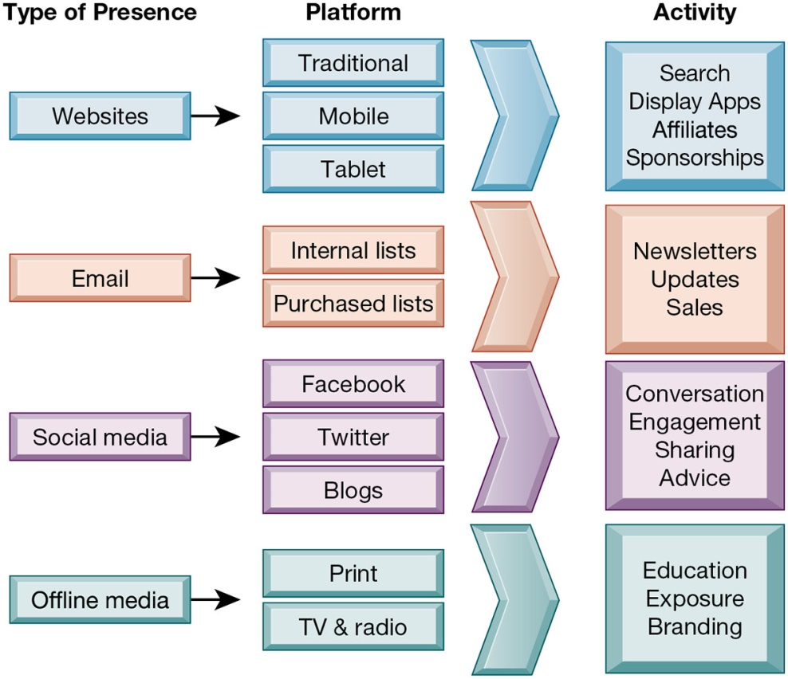
Figure 10.10 E-Commerce Presence Map
Notes:
Figure 10.10, Page 407.
An e-commerce presence requires firms to consider the four types of presence, with specific platforms and activities associated with each.
Full description: This graphic illustrates an e-commerce presence map with four types of presences and the platforms and activity involved. A website presence uses traditional, mobile, and tablet platforms, and activities include search, display apps, affiliates, and sponsorships. An email presence uses platforms of internal lists and purchased lists, with activities of newsletters, updates, and sales. A social media presence uses the platforms of Facebook, Twitter, and blogs, and involves the activities of conversation, engagement, sharing, and advice. The offline media presence uses the platforms of print and TV and radio and involves the activities of education, exposure, and branding.

Slide 35
How Will M I S Help My Career?
The Company: SportsFantasy Empire
Position Description: Junior e-commerce data analyst
Job Requirements
Interview Questions
Author Tips
Notes:
A good opportunity for a class discussion of the new Section on careers. Would any in the class be interested in a job like this? What do they think are the most important skills the employer is looking for? How would they answer the interviewer questions?

Slide 36

Copyright
This work is protected by United States copyright laws and is provided solely for the use of instructors in teaching their courses and assessing student learning. Dissemination or sale of any part of this work (including on the World Wide Web) will destroy the integrity of the work and is not permitted. The work and materials from it should never be made available to students except by instructors using the accompanying text in their classes. All recipients of this work are expected to abide by these restrictions and to honor the intended pedagogical purposes and the needs of other instructors who rely on these materials.

